Slide 1
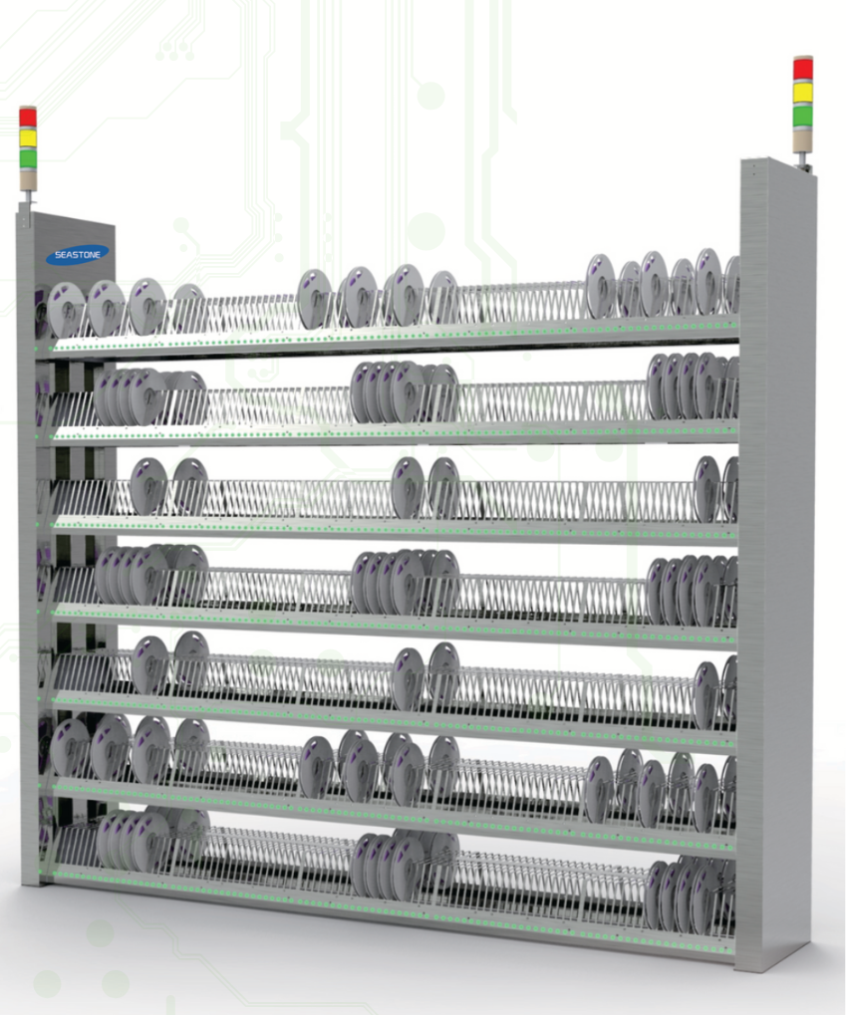
REEL ELECTRONIC MATERIAL SENSOR INTELLIGENT SHELF
Product Introduction:
Sensor intelligent material rack is a technical innovation of electronic warehouse / SMT production line, automatically recording and ensuring the location of storage materials to prevent human error.
Seamless access to materials and error prevention.
Realize the communication with the mounter and complete the function of fastcalling and finding materials.
Features:
Accurate recording of the position of the material tray Real-time tracking of material position
Seamless docking ERP&MES
Power-off Data Preservation
Human error alarm
Reduce the time of finding materials artificially
Docking with the data of the mounter to realize fast material searching
Anti-dementia,firstin,first out
Intelligent digital management
Technical Parameter:
Model | SYTSS1400GB | SYTSS1100GB |  | SYTSS250GB
FORM | FIXED | FIXED |  | FIXED
DIMENSION | 2280*400*1950mm | 2280*400*1950mm |  | 2280*400*1950mm
APPLICABLE | 16MM FOR 7’’ REELS | 16MM FOR 7’’ REELS | 37MM FOR 13’’ REELS | 37MM FOR 13’’ REELS
PLATE NUMBER | 1400 | 1000 | 100 | 250
LAYER NUMBER | 7 | 5 | 2 | 5
SURFACE NUMBER | DOUBLE-SIDED | DOUBLE-SIDED | SINGLE-SIDED | SINGLE-SIDED
*These parameters and pictures are for reference only,so actual products may vary.And the products can be customized.

Slide 2
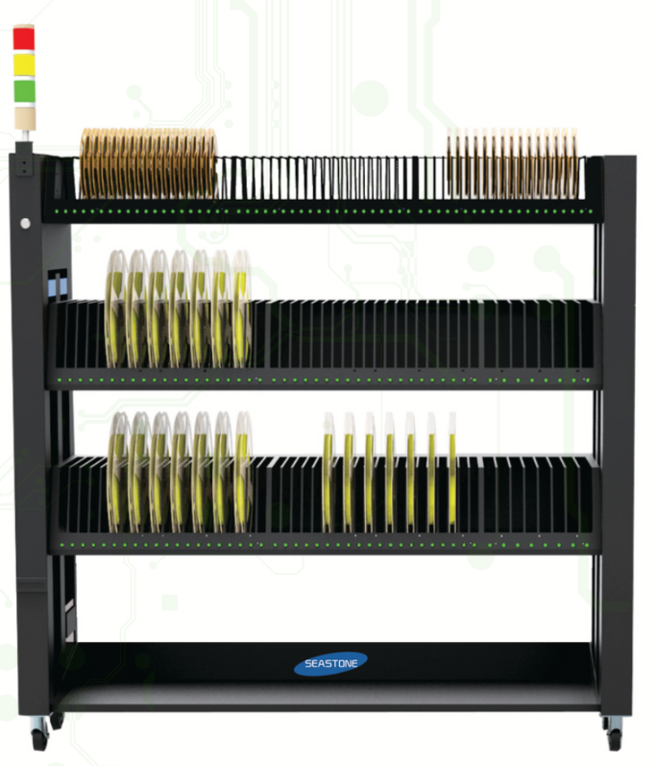
PLATE MOUNTED ELECTRONIC MATERIAL MOBILE SENSOR INTELLIGENT MATERIAL RACK
Features:
Wi-fi communication
Large Capacity Lithium battery power supply can work continuously up to 48 hours
The open communication interface can interface with any system,including chip processor,to realize direct call
Mes Check Material Status,WMS ERP calculate material inventory
Easy Mobility,you can use AGV in electronic warehouse and then to the production line,can also be in theproduction line directly prepared sheet
Intelligent docking of warehouse and production line
Technical Parameter:
Model | SYTSS630YB |  | SYTSS510YB |  | SYTSS390YB
FORM | MOBILE |  | MOBILE |  | MOBILE
DIMENSION | 1500*400*1770mm |  | 1500*400*1510mm |  | 1500*400*1510mm
APPLICABLE | 16MM FOR 7’’ REELS | 37MM FOR 13’’ REELS | 16MM FOR 7’’ REELS | 37MM FOR 13’’ REELS | 16MM FOR 7’’ REELS | 37MM FOR 13’’ REELS
PLATE NUMBER | 600 | 30 | 480 | 30 | 360 | 30
LAYER NUMBER | 5 | 1 | 4 | 1 | 3 | 1
SURFACE NUMBER | DOUBLE-SIDED | SINGLE-SIDED | DOUBLE-SIDED | SINGLE-SIDED | DOUBLE-SIDED | SINGLE-SIDED
*These parameters and pictures are for reference only,so actual products may vary.And the products can be customized.

Slide 3
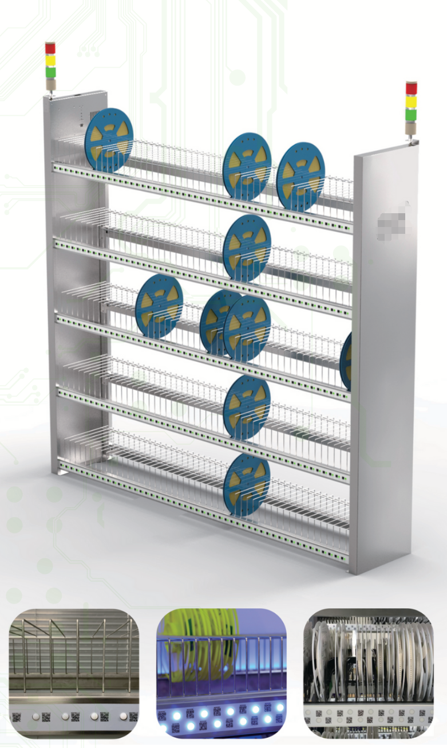
SMT FIXED TWO-DIMENSIONAL CODE RACK
Features:
Realize one-to-one digital and lean management and control of electronic materials,the whole process ofusing link can be traced
Adopt intelligent material warehouse to automatically prepare materials,reduce the workload of materialpreparation personnel by more than 90%
Through deep integration with MES system,the whole process is paperless and automatic.
Material Preparation is strictly in accordance with the principles of tailings priority,first in,first out and so on,so as to reduce the production of dull materials,reduce the cost of materials into the charging and error prevention system,ensure the correct rate of material loading,reduce the losscaused by material loading error
Digital,information,intelligent management,to open up materials,finished goods circulation information,to ensure the consistency of accounts
Technical Parameter:
Model | GDLJ1400B | GDLJ1100B |  | GDLJ250B
FORM | FIXED | FIXED |  | FIXED
DIMENSION | 2110*370*1900mm | 2110*370*1900mm |  | 2110*370*1900mm
APPLICABLE | 16MM FOR 7’’ REELS | 16MM FOR 7’’ REELS | 37MM FOR 13’’ REELS | 37MM FOR 13’’ REELS
PLATE NUMBER | 1400 | 1000 | 100 | 250
LAYER NUMBER | 7 | 5 | 2 | 5
SURFACE NUMBER | DOUBLE-SIDED | DOUBLE-SIDED | SINGLE-SIDED | SINGLE-SIDED
*These parameters and pictures are for reference only,so actual products may vary.And the products can be customized.

Slide 4
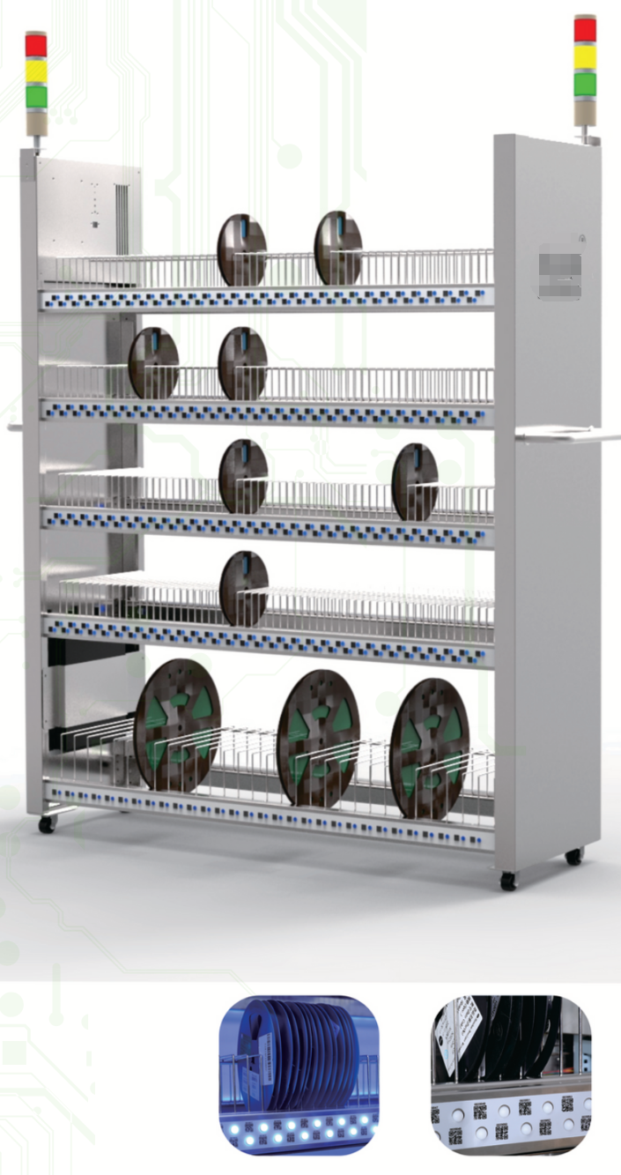
SMT MOBILE TWP-DOMENSIONAL CODE RACK
Features:
Wi-fi communication.
Large Capacity Lithium battery power supply can work continuously up to 48 hours
The open communication interface can interface with any system,including chip processor,to realize direct call.
Mes Check Material Status,WMS ERP calculate material inventory
Easy Mobility,you can use AGV in electronic warehouse and then to the production line,can also be in theproduction line directly prepared sheet
Intelligent docking of warehouse and production line
Technical Parameter:
Model | YDLJ630B |  | YDLJ510B |  | YDLJ390B
FORM | MOBILE |  | MOBILE |  | MOBILE
DIMENSION | 1330*400*1830mm |  | 1330*400*1550mm |  | 1330*400*1550mm
APPLICABLE | 16MM FOR 7’’ REELS | 37MM FOR 13’’ REELS | 16MM FOR 7’’ REELS | 37MM FOR 13’’ REELS | 16MM FOR 7’’ REELS | 37MM FOR 13’’ REELS
PLATE NUMBER | 600 | 30 | 480 | 30 | 360 | 30
LAYER NUMBER | 5 | 1 | 4 | 1 | 3 | 1
SURFACE NUMBER | DOUBLE-SIDED | SINGLE-SIDED | DOUBLE-SIDED | SINGLE-SIDED | DOUBLE-SIDED | SINGLE-SIDED
*These parameters and pictures are for reference only,so actual products may vary.And the products can be customized.

Slide 5
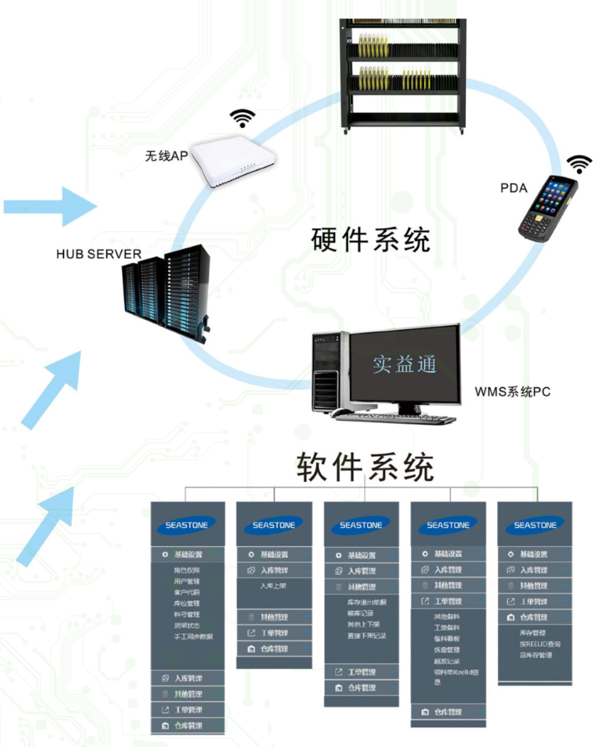
SMT PERFECT STORAGE SOLUTIONS
Raw Material Information Collection:
A supplier of raw materials has import QR code,use direct electronic receiving warehousing shelves supporting the WMS system
If not import the raw material supplier QR code,electronic form a complete set of shelves after the WMS system can print qrcode,print QR code to the tray,QR code content is as follows:(P/N),(Lot number),(Date),(Quantity),(Vendor)
Scan the QR code receiving complete material reelid data warehousing collect generate inventory list,do not need to staff on the number of points differences do not need to press place arrangement,can be directly loaded.
Electronic material actual control logic Put in storage Prepare materials Take the material For sending

Slide 6
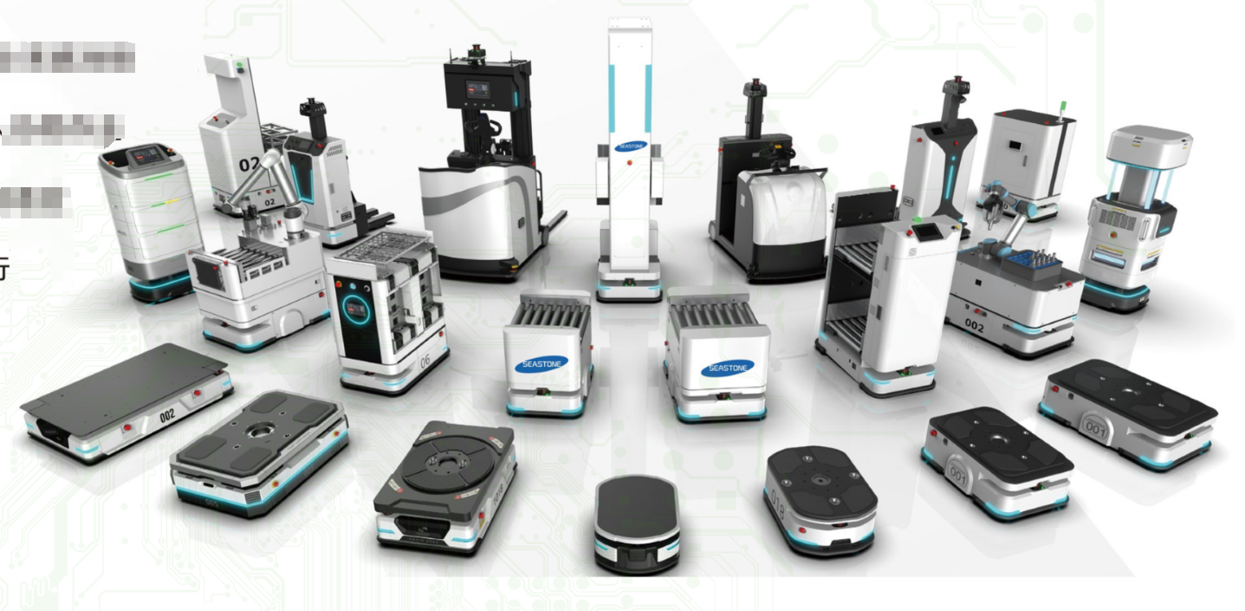
HANDLING ROBOT
Basic service functions
Map management equipment management path planning
Cluster scheduling data monitoring task allocation
User management rights management
Warehouse Management System (WMS)
Inventory management material management
Backend service warehouse management
RloT open platform
Protocol plug-in library device communication driver module
Third-party software system interface
Third-party hardware device interface
Central control system (FCS)
Massive resource management
Visual control process orchestration
Business logic execution container
Cross-scenario and device/system docking
Multiple types of robots working together
Pose recognition and adaptation
Complex scene operation
Obstacle avoidance
Precise positioning

Slide 7
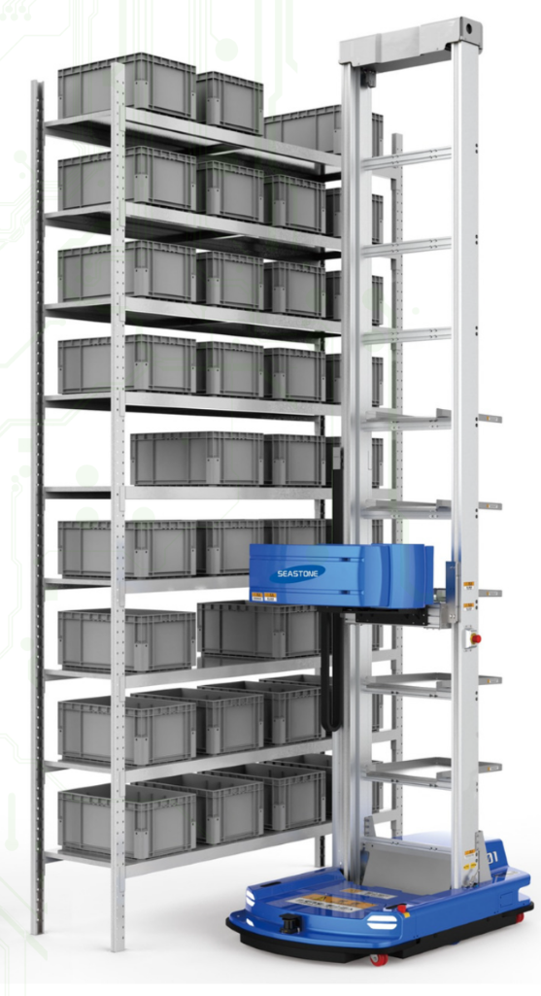
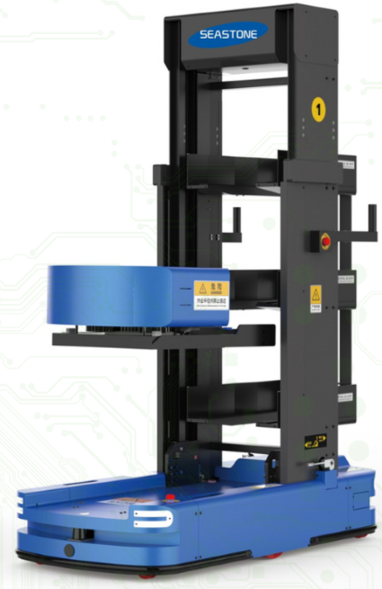
AUTONOMOUS CASE-HANDLING ROBOT
Features:
Box-type warehousing robot can realize intelligent picking, storage and retrieval of boxes, and transport multiple boxes at the same time.
Flexible customization of robot height, optional double-depth model, efficient use of storage space.
The efficiency of human-machine collaborative work is increased by 3-4 times, improving the efficiency of manual work per unit time.
High-speed and stable movement.
Business flexibility, compatible with multi-size boxes and carton picking.
Intelligent picking and handling, autonomous picking, intelligent handling, autonomous navigation, autonomous charging, and high positioning accuracy.
Equipped with many safety functions such as obstacle detection, active obstacle avoidance, anti-collision, alarm and emergency stop.

Slide 8
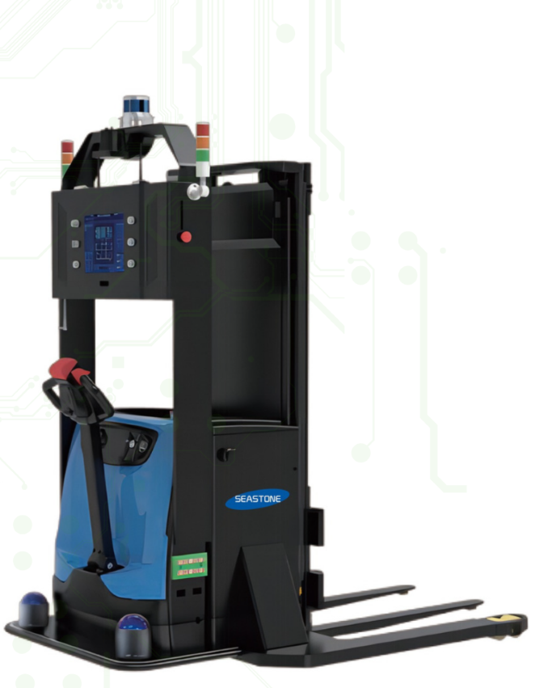
UNMANNED FORKLIFT ROBOT
Features:
Equipped with multiple 3D multi-line laser radars with superior performance to provide stable and rich 3D environmental information for unmanned forklifts, achieving all-round super perception capabilities
Suitable for various indoor and outdoor scenes, it can accurately identify pallets and navigate to avoid obstacles day and night, achieving trouble-free operation in all weather and all scenes
It has high stability, high reliability, high maintainability and high security, and its comprehensive cost advantage is world-leading
The standard API interface is compatible with a variety of system software, and also supports WMS, WCS, FMS, and intelligent warehouse location monitoring systems to assist in the management of unmanned operations
There is no need to deploy auxiliary facilities in the environment, and the use cycle is short; it also supports 7*24h unmanned operations and supports intelligent multi-machine scheduling, greatly improving work efficiency
Autonomous positioning and navigation
Intelligent identification and positioning of pallets
Multiple safety protection warnings
Sensor integration and motion control
Power monitoring and automatic recharging
Intelligent multi-machine scheduling
Automatic fork unloading

Slide 9
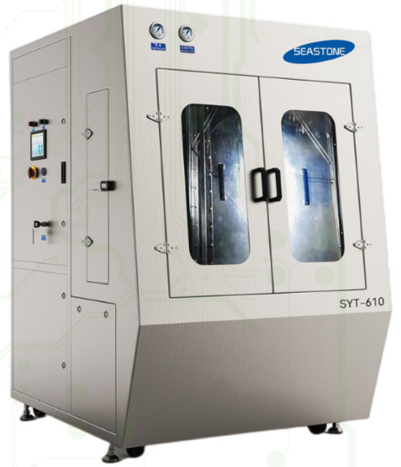
SYT-610 WATER BASED SCREEN CLEANING MACHINE
Product Introduction:
This water-based stencil cleaning machine is mainly used for cleaning SMT stencils in the electronics industry using water-based cleaning liquid. Use the industry's most advanced cleaning process to achieve 100% cleanliness and environmental protection.
The machine consists of cleaning system, rinsing system, drying system and filtering system. The machine uses electricity and compressed air as energy source. Manually place the stencil into the cleaning room. After setting the cleaning, rinsing, drying and other related parameters on the touch screen, press the start button and the stencil will be automatically cleaned and rinsed. and dry. When the set cleaning process ends, it automatically stops running and resets to implement the next work process. This machine is very convenient for workers to clean the stencil, greatly improving production efficiency and quality. It is a new, high-performance, fully automatic cleaning equipment. The equipment uses water-based liquid cleaning agents and DI water for rinsing, which has no safety hazards and no harm to personnel.
Features:
High-pressure spray system specially used for cleaning stencils, misprinted boards, PCB/PCBA and other processes with water-based cleaning fluid.
Double liquid tanks, equipped with heating system, can meet the needs of cleaning, rinsing and hot air drying.
Process flow: cleaning-chemical isolation-rinsing (open loop/closed loop)-drying.
Preparation of advanced fully automatic touch screen operation software makes program file saving and use extremely simple.
The system counting function can automatically accumulate the number of cleaning stencils and the number of cycle filtrations.
Liquid and pump pressure can be displayed through the panel pressure gauge, providing timely feedback on the operating status of the equipment.
The spray pressure is monitored by a pressure sensor. If the pressure exceeds the set pressure range, an alarm will occur.
BEFORE ➡️ AFTER

Slide 10
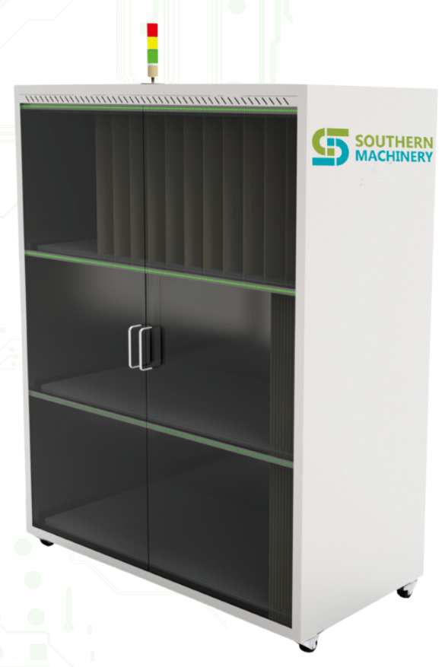
Advanced Efficiency Enhancer: SMT Stencil Intelligent Storage Cabinet For Optimal EMS Production"
1.Compact Design:
Maximizes workspace with high storage in minimal footprint.
2.MES/ERP Compatibility:
Ensures smooth integration with maAnufacturing systems.
3.Efficiency Boost:
Quick stencil access optimizes production speed.
4.Ample Storage:
Fits 80 steel meshes in a streamlined structure.
5.Easy Retrieval:
Designed for fast and precise mesh location.
Features | Details Information
Dimensions: | 1740*770*1800mm
Communication Part: | Seamless docking with MES/ERP
Software: | Improves efficiency and quickly locates steel mesh
Storage Capacity: | Capable of storing 80 steel meshes and 2 layers of 736*736*30mm steel mesh
Benefits: | Reduces the space occupied,and enhances operational efficiency

Slide 11
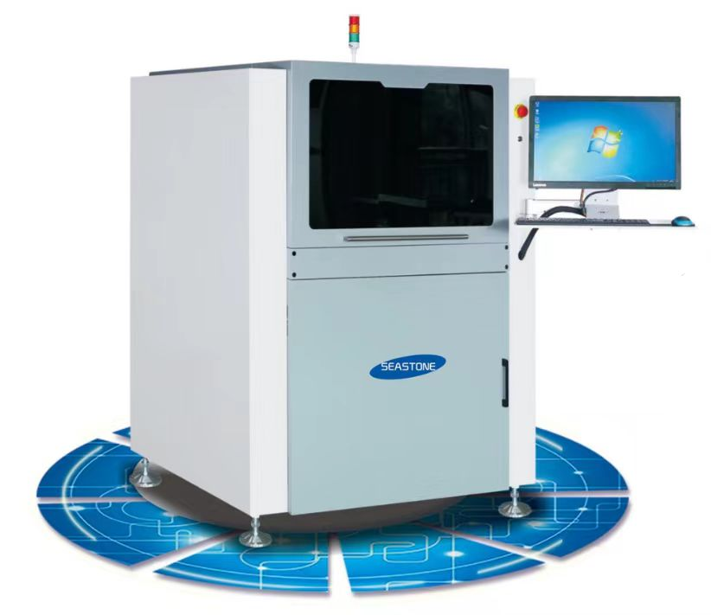
SMYT-30 Automatic Stencil Measuring Machine
Product Introduction:
Detection Function:
1. Automatic steel mesh mesh test
Location, size, quantity, accuracy, foreign matter,
tension, burrs, damage;
2. Automatic tension test
High-precision tensiometer, automatic multi-position testing;
3. Automatic scraper detection
Optional scraper straightness detection
4. 3D steel mesh thickness measurement
Optional steel mesh wall thickness intuitive
Measurement;
5. Steel mesh deformation scanning
Optional scanning and observation of steel mesh surface deformation;
6. PCB plane measurement
Optional detection of PCB pad size, position, etc
The fully automatic stencil measuring machine is a device for high-precision
measurement and inspection of printing stencils. The main purpose is to inspect
the steel mesh incoming materials, conduct quality control on the use and cleaning
of the steel mesh, optimize the process research and measurement of the steel
mesh openings, and at the same time automatically record and upload the steel
mesh incoming materials-acceptance inspection-warehousing-use-cleaning.
Cleaning, testing, warehousing, and scrapping to achieve automated management
of the entire information chain;
It makes up for the shortcomings of low manual inspection efficiency, poor quality,
inability to manage and trace data, and inability to improve processes, and provides
an important reference for the improvement and control of printing processes.
Software Function
1. Steel mesh information management system
2. GERBER file comparison function
3. Steel mesh barcode scanning information management,
fast barcode program management
4. SPC data statistics and data reporting functions;
5. Automatic offline programming software supports automatic GERBER file programming
6. MES system data docking and uploading, supporting
MES information upload and management functions;
Steel mesh incoming material verification:
1. Steel mesh incoming material inspection
2.Steel mesh acceptance control
3. Research on the correctness of steel mesh openings
Steel mesh cleaning inspection:
1. Confirmation of steel mesh cleaning effect
2. Steel mesh hole plugging control
3. Control of changes in steel mesh tension and accuracy
Process research reference:
1. Comparison of stencil accuracy and assessment of stencil opening supplier capabilities
2. Simulate the tin amount in advance and conduct research on the rationality of hole opening.
3. Steel mesh tension, accuracy change control, parameter reference
4. Various detailed and accurate data provide objective reference

Slide 12
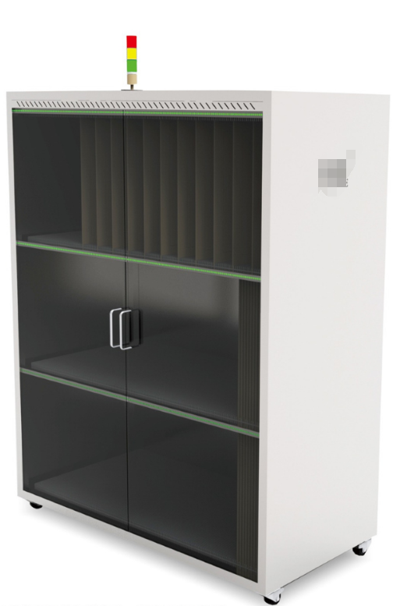
Steel Stencil Storage Cabinet
Steel Stencil Storage Cabinet GWCCG300
Hardware +communication port+software
Dimension of equipment:1340mm*650mm*2100mm
Seamless docking with MES/ERP ,reduce the space occupied
Improve efficiency and find steel mesh quickly
It can store 300 and 3 layers of 570*570*6mm steel mesh
Steel Stencil Storage Cabinet GWCCG120
Hardware +communication port+software
Dimension of equipment:740mm*770mm*2200mm
Seamless docking with MES/ERP ,reduce the space occupied
Improve efficiency and find steel mesh quickly
It can store 40 and 1 layers of 736*736*30mm steel mesh
It can store 80 and 2 layers of 550*650*60mm steel mesh
Steel Stencil Storage Cabinet GWCCG80
Hardware +communication port+software
Dimension of equipment:1740mm*770mm*1800mm
Seamless docking with MES/ERP ,reduce the space occupied
Improve efficiency and find steel mesh quickly
It can store 80 and 2 layers of 736*736*30 mm steel mesh
*These parameters and pictures are for reference only,so actual products may vary.And the products can be customized.

Slide 13
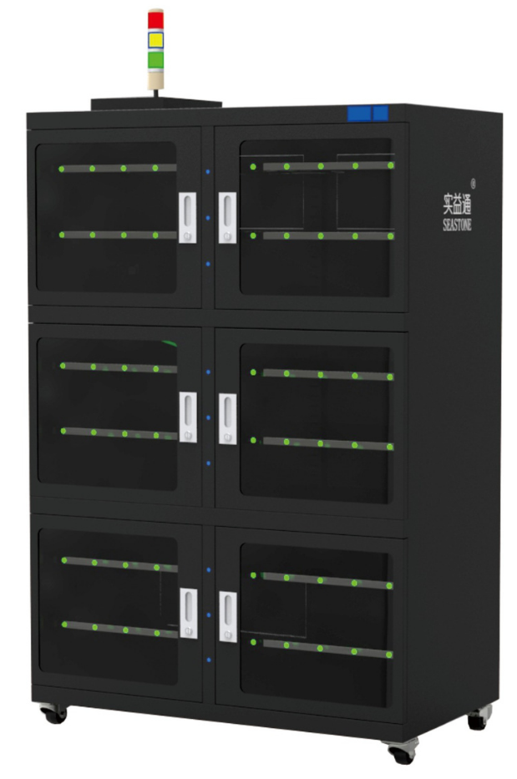
Smart Moieture-Proof Cabinet
Specifications:
Equipment Model:FCG-1500
Equipment main size:1200*650*1800mm
Equipment whole adopt stainless steel plate,laser cutting,stamping forming,Argon Arc welding precision welding
Cabinet door with 5 mm toughened safety glass
Humidity independent channel control (constant humidity),humidity positive fluctuation is low (<2% RH)
Temperature and humidity alarm terminal over temperature and over humidity alarm output
Dehumidification speed is fast:60% RH ambient humidity,60 minutes up to 10% RH
Humidity stable state maintenance time long (intelligent constant operation)
Temperature and humidity remote bidirectional monitoring (WIFl/GPRS condition realization)
Energy consumption extremely low,online power 5 watts
Nitrogen function(optional)
*These parameters and pictures are for reference only,so actual products may vary.And the products can be customized.

Slide 14
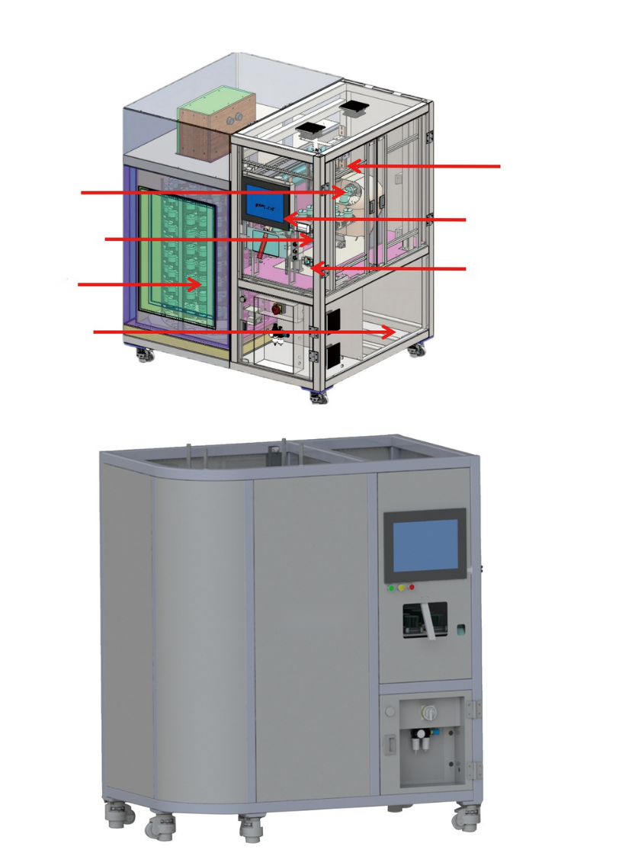
Solder paste/glue Intelligent Storage Cabinet
Product Introduction:
The intelligent solder paste/glue storage management cabinet is mainly suitable for SMT related industries. Its main function is to help the SMT production line to store, rewarm, stir, send and receive materials, etc. of solder paste/glue. At the same time, it can monitor the status of solder paste/glue, Intelligent management of type, shelf life and other information can assist SMT production lines to implement high-efficiency and high-quality production methods, thereby achieving the purpose of lean production.
This equipment is also suitable for intelligent storage of red glue, silver paste, silica gel and other similar raw materials.
Handling mechanism
Mixer
Control and data storage systems
Solder paste temperature recovery area
Fingerprint recognition and label printing
Refrigerated area
Cooling System
Features:
Automatic refrigerated storage, temperature recovery, mixing and dispensing
Support online reservation for solder paste/glue recovery and collection
Solder paste/glue will be automatically scrapped after refrigeration timeout and temperature recovery timeout.
Connect with customer MES/SFCS system
Storage capacity: 160 cans, FIFO controlled according to Datecode, supports a variety of solder pastes
Scan codes for entering, leaving, warming, stirring, and retrieving materials, time for entering, refrigerating, rewarming, mixing, and retrieving materials, storage and retrieval information
The temperature return zone has a capacity of 17 bottles and supports a variety of solder pastes.
It can stir 1 or 2 cans of solder paste at the same time, and supports setting different rotation speeds and times for different solder pastes.
Full data tracking and storage such as refrigeration temperature
Information management
*These parameters and pictures are for reference only,so actual products may vary.And the products can be customized.

Slide 15
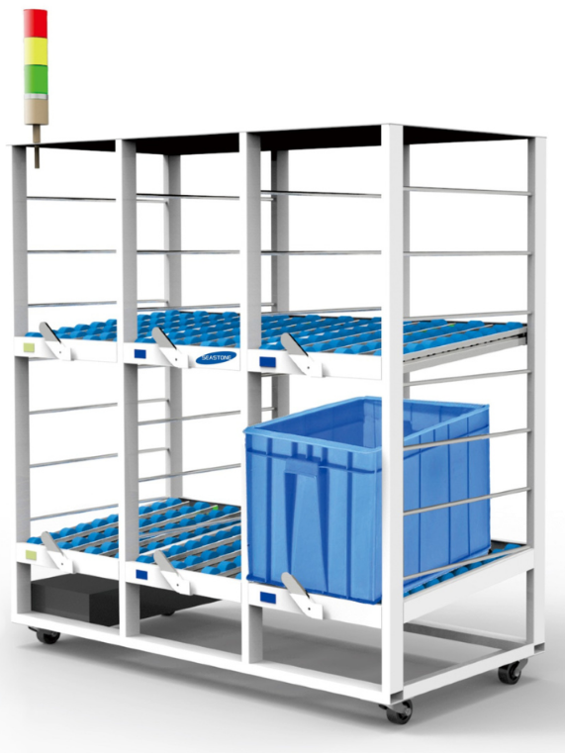
Lighting Inspection Storage for SMT
Product Introduction:
Material goes in the back end and out the front end!
Material Information and location information binding,to achieve rapid picking
The front-end electronic label prompt picks goods,picks goods to finish,lights out the system automatically updates the data!
Product Specification:
Dimensions :1070*500*1040mm
*These parameters and pictures are for reference only,so actual products may vary.And the products can be customized.

Slide 16
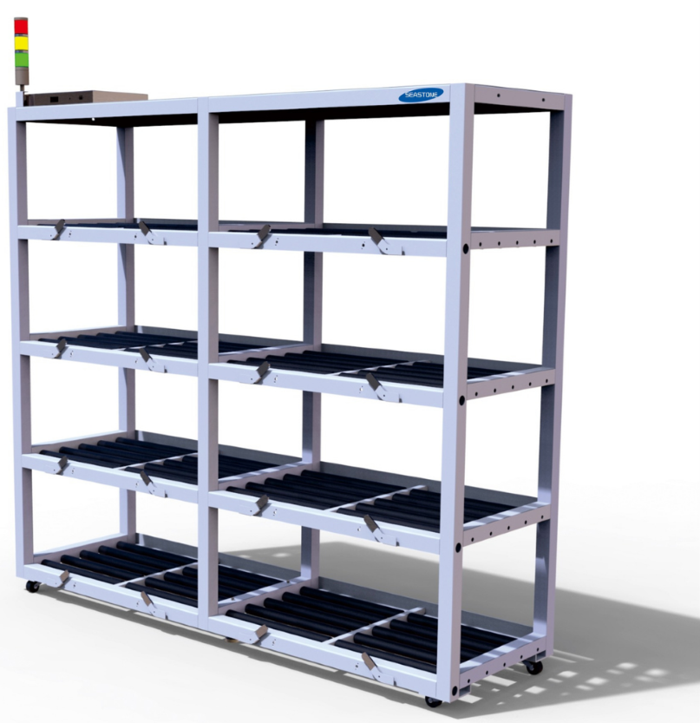
Fixture Shelf Racks of SMT and Auto Insertion Line
Product Introduction:
Rack Model:ZJHJ16
Equipment Body Size: 2040mm*600mm*1800mm
4 layers,each layer 4 storage location,a total of 16 storage location
Hardware +Communication Port +software
Connect with the MES/ERP/WMS system seamless docking
Reduce the SPACE
Improve efficiency,SEARCH THE FIXTURE QUICKLY
*These parameters and pictures are for reference only,so actual products may vary.And the products can be customized.

Slide 17
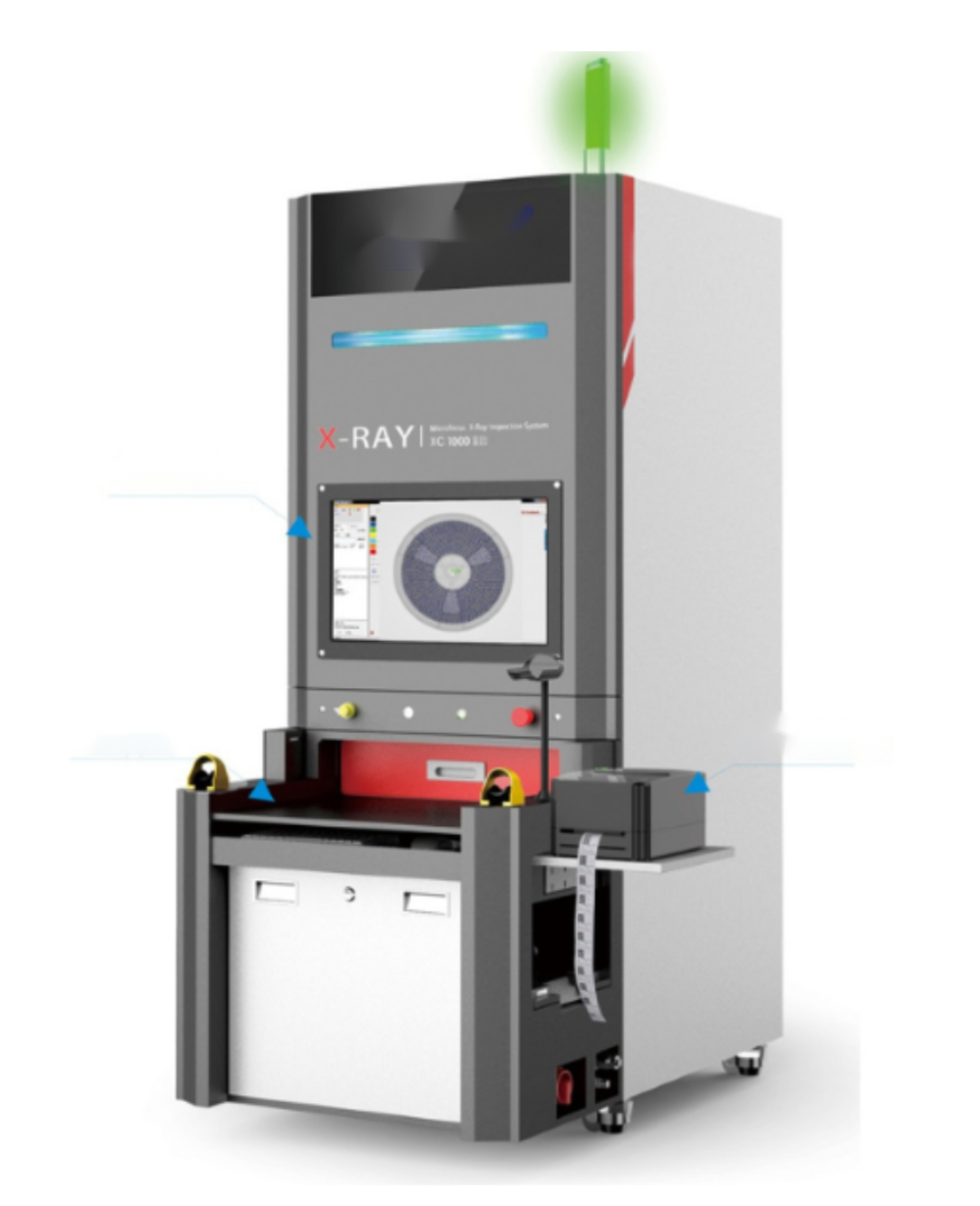
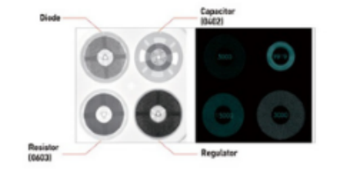
Semi-automatic counting machine X-Ray Solution XC-1000
Product Specification:
BASIC | Dimensions | 0.8M*1.26M*1.92M
 | Equipment Weight | 800KG
 | Voltage | AC110/220V±10%,50/60Hz
 | Total Power | Max 800W
 | Feeding Method | Manual placement, automatic tray entry and exit.
 | Material Foolproof | The tray is fully inductive, automatically identifying and printing information on the tray being picked up.
OTHERS | Counting Time | 4 disks at the same time, about 12 seconds
 | Counting Accuracy | 01005 can reach 99.99%. 0201 or above 100%
 | Barcode Scanning | Built-in camera automatic recognition (external barcode scanner)
 | Label Printing | Capable of printing material codes and counting results in real time
 | Detection Components | Resistors, capacitors, inductors, crystal oscillators, LEDs, diodes, transistors, multi-pin ICs, etc.
 | Software | Supports automatic saving of SPC statistics, pictures and results in any format
 | Docking System | ERP, MES, etc.
 | Radiation Leakage | <1 μSv/Hour
Touchscreen
Loading door
Barcode Printer
Product Advantages:
The X-ray source adopts the American VJ closed X-ray tube, which has a long life and is maintenance-free.
17-inch ultra-clear flat-panel detector, fast imaging and no distortion.
Simultaneously calculating four 7-inch material trays or one 13-17-inch material tray mcan does not need to spend 3-5 days to enter data on the material trays in the factory. Users can directly use the algorithm/database with permanent free updates and support
There is no need to open the packaging bag to maintain the integrity of the material roll and will not affect the moisture resistance of the material.
It greatly reduces the counting time and eliminates redundant manpower. It can then assist other personnel to close or change lines, shortening the time for line changes and line changes.
The smart dispensing machine can print barcode stickers or directly upload to the database.
Compared with the traditional method of counting instruments, each operator must have one, which takes up a lot of space. The counting results are still filled in manually, and there may be errors or omissions
Meet the trend of Industry 4.0 and SMT production lines, which are smarter, fewer people and more efficient
*These parameters and pictures are for reference only,so actual products may vary.And the products can be customized.

Slide 18
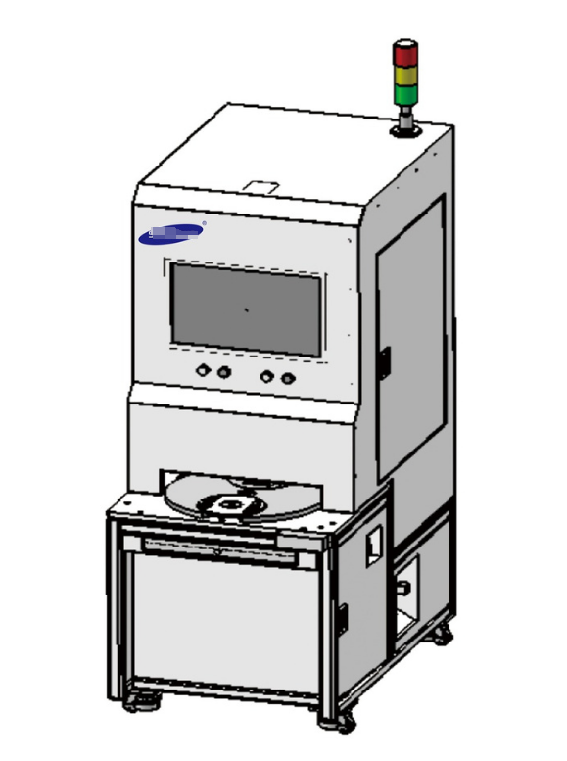
Semi-Automatic Tray Labeling Machine Lable Man 5000-01
(LableMan 5000-01 )7-inch tray semi-automatic labeling machine is a tray semi-automatic labeling machine for the electronic components industry. It is designed and developed to automatically print and attach customer labels (tray labels) for 7-inch tray products in the industry. Solution for manual single tray loading and unloading. The device can complete functions such as original label reading, customer label printing, and customer label attachment within 4.5 seconds, saving operators a lot of valuable time.
Product
Specification:
Environment | Applicable Environment Temperature | 5 ℃~40 ℃,humidity 20%~80%
Efficiency | Equipment Efficiency | 4.5 seconds/disk (efficiency is obtained when simulating the WMS interface,there will be differences due to different WMS network interfaces)
 | UPH | 640 plates/hour (80% utilization rate)
 | Labelingaccuracy | ≤±2mm
 | Failurerate | ≤0.5%
Functions | Scancode,generate labels,label,and check | Support
Dimensions | length/width/height | 700mm/640mm/1030mm
 | Weight | 200kg
Electrical | Input Voltage | 220V
 | Rated Power | <2 KW
 | Rated Current | 5 A
Compressed Air | Compress Air | ≥0.5 MPa
 | Nominal Consumption | Approx. 6 m³ /h at 0.55 MPa
 | Air Connection Diameter | 8 mm
 | Water and Oil Filtration Grade | Three-Stage Filtration (water removal,oil removal)
Applicable Tray Model | Diameter | 180±2mm
 | Thickness | 10±2mm
Label Specifications | Compatible Length | 50-120mm
 | Compatible Width | 15-50mm
Ribbon Specifications | Compatible Length/Width | ≥1016×104(mm),up to 600M
Optional Parts | *Disk label printer | Zebra 300 dpi
 | *Outer box printer | Customized according to customer needs
 | *Outer printer | Customized according to customer needs
 | *Barcode Scanner | Customized according to customer needs
Noise | Noise Level | ≤70 dB
*For optional functions,please contact the business for details. Email:info@smthelp.com
*These parameters and pictures are for reference only,so actual products may vary.And the products can be customized.

Slide 19
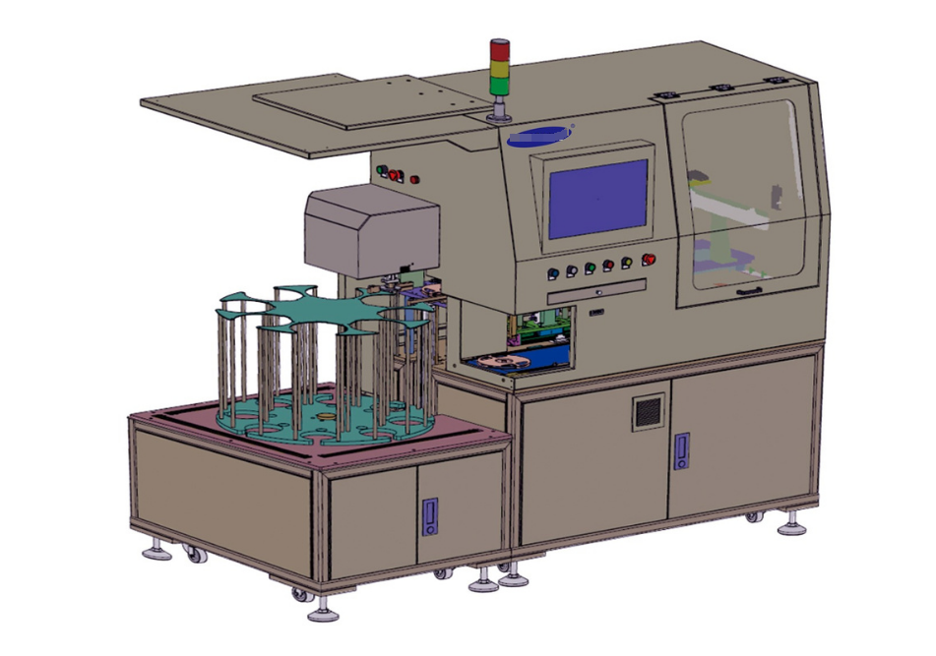
Lable Man 1000-03 Tray Fully Automatic Labeling Machine
Product Specification:
Environment | Applicable Environment Temperature | 5 ℃~40 ℃,humidity 20%~80%
Efficiency | Equipment Efficiency | 1.8 seconds/disk (efficiency is obtained when simulating the WMS interface,there will be differences due to different WMS network interfaces)
 | UPH | 1440 plates/hour (80% utilization rate)
 | Labelingaccuracy | ≤±1mm
 | Failurerate | ≤0.5%
Functions | Scancode,generate labels,label,and check | Support
 | Compatible with non-original label mode (incoming materials have no original label) | Support
 | Compatible with calibration mode (read-only code without labeling) | Support
Dimensions | length/width/height | 2020mm/1450mm/1900mm
 | Weight | 800kg
Electrical | Input Voltage | 220V
 | Rated Power | <2KW
 | Rated Current | 10A
Compressed Air | Compress Air | ≥0.5 MPa
 | Nominal Consumption | Approx. 6 m³ /h at 0.55 MPa
 | Air Connection Diameter | 8 mm
 | Water and Oil Filtration Grade | Three-Stage Filtration (water removal,oil removal)
Applicable Tray Model | Diameter | 180±2mm
 | Thickness | 10±2mm
Label Specifications | Compatible Length | 50-120mm
 | Compatible Width | 15-50mm
Ribbon Specifications | Compatible Length/Width | ≥1016×104(mm),up to 600M
Optional Parts | *Disk label printer | Zebra 300 dpi
 | *Outer box printer | Customized according to customer needs
 | *Outer printer | Customized according to customer needs
 | *Barcode Scanner | Customized according to customer needs
 | *Receiving line | Customized according to customer needs
Noise | Noise Level | ≤70 dB
*For optional functions,please contact the business for details. Email:info@smthelp.com
Lable Man 1000-03
7-inch tray fully automatic labeling machine is an automatic tray labeling machine for the electronic components industry. It is designed and developed to automatically print and attach customer labels (tray labels, Box labels, box labels) solutions. The equipment can complete functions such as original label reading, customer label printing, customer label affixing, and automatic pallet stacking within 1.8 seconds, which can save operators a lot of valuable time.
*These parameters and pictures are for reference only,so actual products may vary.And the products can be customized.

Slide 20
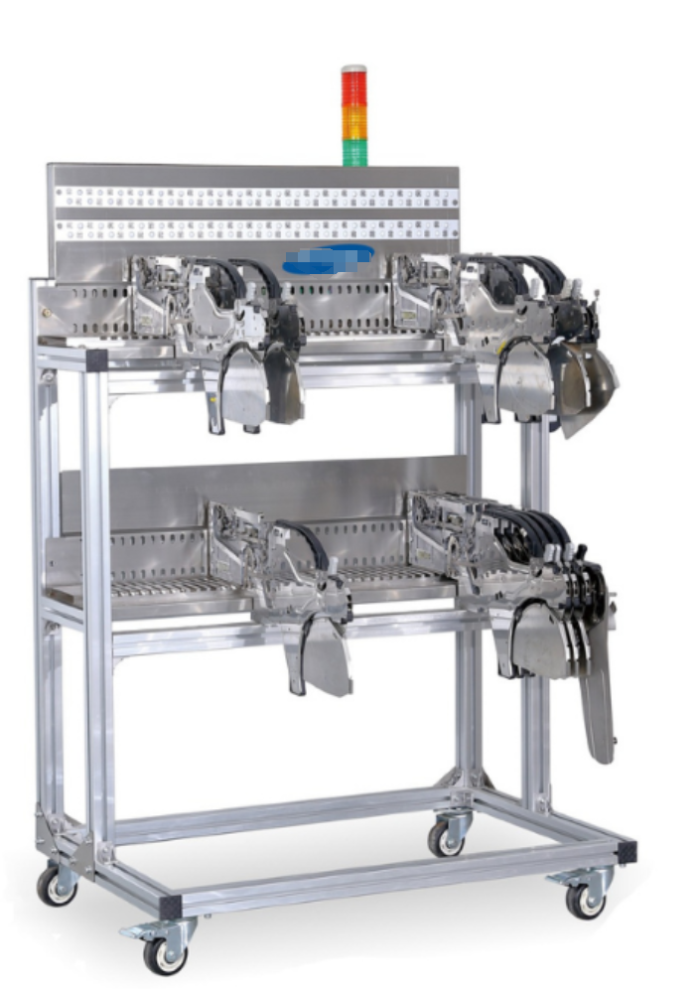
Intelligent Feeder Turnover
Product Specification:
Hardware+Communication Port+Software
Feeder Turnover FDZZC100
Dimensions of equipment:950mm*620mm*1380mm(according to the model of SMT,the flying distance is different)
Seamless clocking with MES/ERP
Realize fast line transfer
Improve efficiency and find materials stored on guns quickly
Storage 8 mm electronic gun 1002 layers
Self-contained lithium battery or can be directly charged,continuous power supply 24 hours
*These parameters and pictures are for reference only,so actual products may vary.And the products can be customized.

Slide 21
Best After-sales service
— 7x24 Worldwide Support
— Free Installation/ Training
— 1 day lead-time (spare parts)
— 1 Month customize solution

Slide 22
Welcome Inquiry
Please visit
www.smthelp.com
Find us more
https://www.facebook.com/autoinsertion
Know more our team
https://www.linkedin.com/company/smtmachine
Welcome to our factory in Shenzhen China
See more machine working video, please Youtube
https://www.youtube.com/c/Smthelping
Google
Auto+insertion, to get more information
Looking forward to your email
info@smthelp.com

